Slide 1
CAPSTONE PROJECT
Affective Symbolic Music Generation
Generating Emotion-Conditioned Piano Music from Facial Expressions and Text
School of Computer Science & Engineering • Academic Year 2024–2025
Project Team:
Hemendra Singh (23BAI11347)
Pratham Dholi (23BAI11220)
Sawan Gupta (23BAI10393)
Aditya Mishra (23BAI10249)
Manthan Ugale (23BAI10515)
Rahul Madhuraj (23BAI11307)
Repository: github.com/iamhemendra/affective-symbolic-music

Slide 2
TOPIC BRIEF
What This Project Does
▸ Affective computing meets generative AI: the system reads a person's emotional state from a webcam snapshot or a typed sentence.
▸ Emotion is mapped to Russell's 4-quadrant affect model (Q1-Q4: excited, tense, sad, calm), giving one common signal for two very different input types.
▸ A quadrant-specific GPT-2 model, trained on the EMOPIA piano dataset via MidiTok's REMI tokenization, generates a new polyphonic piano piece in that quadrant's style.
▸ The symbolic output is rendered to real audio with FluidSynth and delivered through a live Gradio web app, alongside a downloadable .mid file.
Affective Symbolic Music Generation
2

Slide 3
THE PROBLEM
Problem Statement
▸ Background and generative music tools today are largely static: a fixed playlist, a mood *tag* picked manually, or pre-recorded loops that repeat regardless of how the listener actually feels in the moment.
▸ Existing symbolic-music generation research (e.g. Music Transformer, MuseNet-style models) focuses on unconditional or genre-conditioned generation; they are not built to react to a live, personal emotional signal.
▸ There is no lightweight, real-time pipeline that takes a face or a sentence, infers affect, and composes new music for that specific emotional state end-to-end — most prior work stops at classification or at offline batch generation.
Affective Symbolic Music Generation
3

Slide 4
GOALS
Objective & Scope
Objectives
Scope
▸ Build a real-time, dual-input (vision + text) emotion recognizer.
▸ Map both modalities onto one shared affect representation.
▸ Train quadrant-specific symbolic music generators on EMOPIA.
▸ Deliver a playable, downloadable output through a live web UI.
▸ Solo piano, monophonic-instrument MIDI output only.
▸ 7 canonical facial emotions; English-language text sentiment.
▸ 4 discrete affect quadrants, not continuous valence/arousal regression.
▸ Prototype-scale models trained on a single Colab GPU session.
Affective Symbolic Music Generation
4

Slide 5
SETUP
Hardware & Software Requirements
Hardware
Software
▸ GPU: NVIDIA T4 (Colab) or any CUDA GPU, 8GB+ VRAM recommended for training.
▸ CPU-only inference is supported but significantly slower.
▸ Webcam or image upload for the facial-expression input path.
▸ ~2-3 GB free disk for the EMOPIA dataset, checkpoints and generated audio.
▸ Python 3.10+, PyTorch, HuggingFace Transformers & Accelerate.
▸ MidiTok (REMI tokenizer) and Symusic for MIDI I/O.
▸ FluidSynth + a General MIDI soundfont for audio rendering.
▸ Gradio for the web UI; OpenCV / Pillow / MediaPipe for image handling.
Affective Symbolic Music Generation
5

Slide 6
PRIOR WORK
Existing Solutions & Their Limitations
What exists today
Where they fall short
▸ Large unconditional symbolic generators (Music Transformer, MuseNet) produce high-quality music but with no notion of a listener's live emotional state.
▸ Rule-based "mood playlist" apps tag tracks by a manually chosen label and play back pre-recorded audio — nothing is actually generated.
▸ The EMOPIA paper itself demonstrates emotion-conditioned generation is feasible, but as an offline research benchmark, not a live application.
▸ No direct pipeline from a face or a sentence to a piece of music.
▸ Discrete manual mood tags instead of an inferred, continuous affect signal.
▸ No integrated audio rendering or interactive delivery layer.
▸ Emotion recognition and music generation are treated as separate research problems, never wired together end-to-end.
Affective Symbolic Music Generation
6

Slide 7
OUR APPROACH
How We Solve These Gaps
Unified conditioning
Real end-to-end delivery
▸ Two independent classifiers (facial FER + text sentiment) are both collapsed onto the same 4-quadrant Russell affect space, so the generator never needs to know which modality triggered it.
▸ This decouples "how emotion was sensed" from "how music is generated."
▸ Four lightweight, quadrant-specific GPT-2 models keep generation fast enough for near-real-time use on a free GPU.
▸ Symbolic output is automatically synthesized to WAV and served — with the raw MIDI available for download — inside one live Gradio interface.
Affective Symbolic Music Generation
7

Slide 8
SYSTEM DESIGN
End-to-End Workflow
STEP 1
STEP 2
STEP 3
STEP 4
STEP 5
STEP 6
STEP 7
Webcam Frame
or Free Text
Emotion Recognition
(7-class FER / DistilRoBERTa)
Affect Quadrant
Mapping (Russell)
Quadrant-wise
GPT-2 Generation (REMI)
MIDI Detokenization
& Assembly
FluidSynth
Audio Synthesis
Gradio UI
(Audio + MIDI Download)
Two input modalities are normalized onto one shared affect representation before generation begins.
Perception
Decision
Generation / Output
Affective Symbolic Music Generation
8

Slide 9
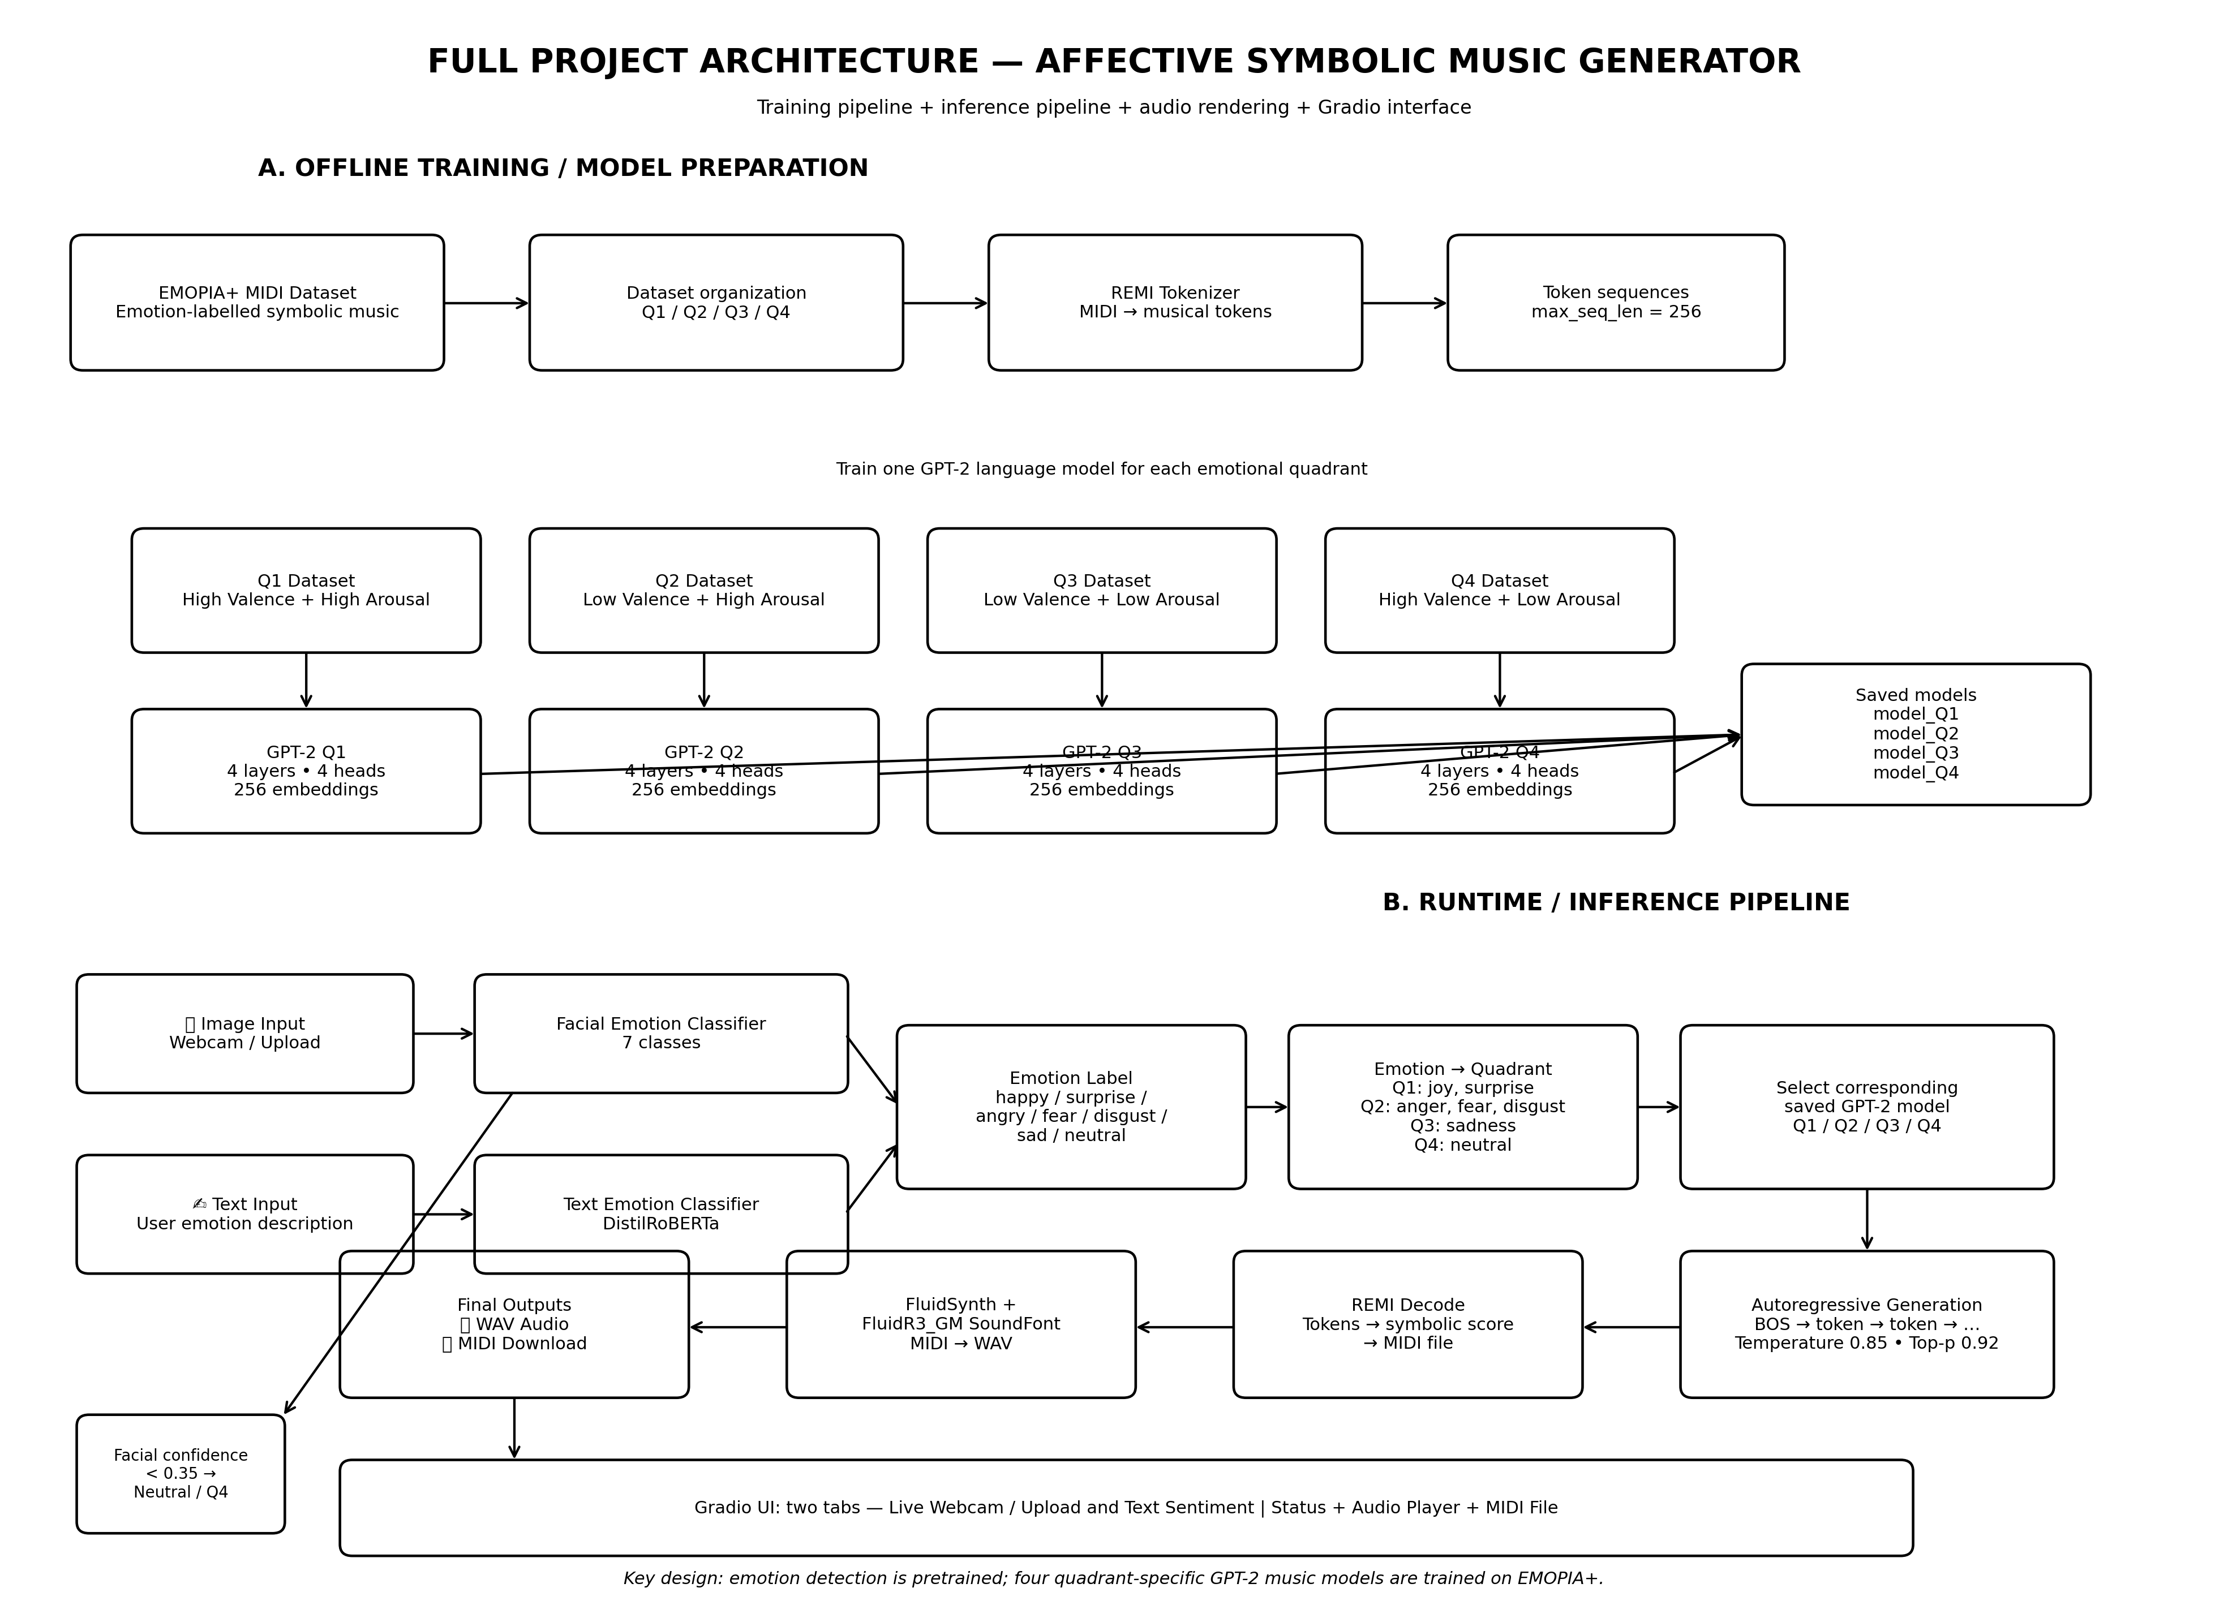

Slide 10
AFFECT MODEL
Russell's Circumplex Model of Affect
Q2
Arousal ↑
Why quadrants?
Q1
Low Valence / High Arousal
High Valence / High Arousal
▸ Both the 7-class facial emotion output and the 7-class text sentiment output are collapsed onto the same 2D valence-arousal space.
▸ This gives one shared, model-agnostic conditioning signal (Q1-Q4) for the generator, regardless of which input modality was used.
▸ Each quadrant has its own dedicated fine-tuned generator, so the music style matches the psychological character of that quadrant.
Angry, Afraid, Disgusted
Happy, Excited, Surprised
Q3
Q4
Valence →
Low Valence / Low Arousal
High Valence / Low Arousal
Sad, Depressed
Neutral, Calm, Relaxed
Affective Symbolic Music Generation
9

Slide 11
LAYER 1 OF 7
Input Layer
Captures the raw signal from the user
▸ Accepts either a live webcam frame / uploaded photo, or a free-text description of how the user feels.
▸ Runs inside the Gradio UI with two dedicated tabs, so both paths share the same downstream pipeline.
Affective Symbolic Music Generation
10

Slide 12
LAYER 2 OF 7
Emotion Recognition Layer
Converts raw input into a labeled emotion
▸ Image path: a 7-class facial-emotion classifier (happy, sad, angry, fear, disgust, surprise, neutral) built on a HuggingFace image-classification pipeline.
▸ Text path: a DistilRoBERTa-based 7-class sentiment classifier scores the input sentence and returns the dominant emotion label plus its confidence.
Affective Symbolic Music Generation
11

Slide 13
LAYER 3 OF 7
Affect Quadrant Mapping Layer
Normalizes both modalities into one signal
▸ Each of the 7 emotion labels (from either modality) is mapped onto Russell's Circumplex Model, resolving to one of four quadrants: Q1-Q4.
▸ Low-confidence facial predictions default to the calm/neutral quadrant (Q4) as a safety fallback.
Affective Symbolic Music Generation
12

Slide 14
LAYER 4 OF 7
Symbolic Generation Layer
Composes new music in the target quadrant's style
▸ A small causal GPT-2 model (4 layers, 4 heads, 256-dim embeddings) — one per quadrant — is fine-tuned on EMOPIA piano MIDI tokenized with MidiTok's REMI representation.
▸ At inference, the quadrant-specific model autoregressively samples a new REMI token sequence (temperature 0.85, top-p 0.92).
Affective Symbolic Music Generation
13

Slide 15
LAYER 5 OF 7
MIDI Detokenization & Assembly Layer
Turns generated tokens back into music notation
▸ The REMI tokenizer decodes the sampled token sequence back into a structured musical score (pitch, duration, velocity, timing).
▸ The score is written out as a standard, playable .mid file.
Affective Symbolic Music Generation
14

Slide 16
LAYER 6 OF 7
Audio Synthesis Layer
Renders the symbolic score to audible sound
▸ A headless FluidSynth process renders the generated MIDI file against a General MIDI soundfont at 44.1kHz.
▸ Output is a standard WAV file; rendering runs with a strict timeout so the UI never hangs on synthesis.
Affective Symbolic Music Generation
15

Slide 17
LAYER 7 OF 7
Presentation Layer
Delivers the result back to the user
▸ A Gradio Blocks app shows the detected emotion/quadrant, an inline audio player for instant playback, and a file widget to download the raw MIDI.
▸ Runs as a single shareable web app — no separate front-end needed.
Affective Symbolic Music Generation
16

Slide 18
APPLICATIONS
Usability of the Application
Direct use cases
Value delivered
▸ Adaptive, mood-matched background music for wellness, meditation or study apps.
▸ Dynamic soundtracks for games and interactive media that react to the player.
▸ A quick prototyping tool for content creators who need mood-specific score ideas.
▸ Lets people with no music-composition training generate an original, emotion-matched piece from a selfie or a sentence.
▸ Demonstrates a practical, teachable bridge between affective computing and generative sequence models.
Affective Symbolic Music Generation
17

Slide 19
WHAT'S NEXT
Scope for Future Improvement
▸ Move from 4 discrete quadrants to continuous valence-arousal regression for finer-grained emotional control.
▸ Extend beyond solo piano to multi-instrument / orchestral generation using richer symbolic representations.
▸ Fuse facial expression, voice tone and text simultaneously for a more robust, multimodal affect estimate.
▸ Replace the small per-quadrant GPT-2 models with a single larger pretrained symbolic-music foundation model, fine-tuned per quadrant, for better long-range musical structure.
▸ Optimize for sub-second streaming generation to support live performance or interactive installations.
▸ Add a user feedback loop (like/dislike or explicit ratings) to personalize generated style over repeated use.
Affective Symbolic Music Generation
18

Slide 20
REFERENCES
Research Paper Citations
# | Citation
1 | Hung, H-T., Ching, J., Doh, S., Kim, N., Nam, J., & Yang, Y-H. (2021). EMOPIA: A Multi-Modal Pop Piano Dataset for Emotion Recognition and Emotion-based Music Generation. Proc. ISMIR 2021, 318-325.
2 | Fradet, N., Briot, J-P., Chhel, F., El Fallah Seghrouchni, A., & Gutowski, N. (2021). MidiTok: A Python Package for MIDI File Tokenization. Late-Breaking Demos, ISMIR 2021.
3 | Russell, J. A. (1980). A Circumplex Model of Affect. Journal of Personality and Social Psychology, 39(6), 1161-1178.
4 | Radford, A., Wu, J., Child, R., Luan, D., Amodei, D., & Sutskever, I. (2019). Language Models are Unsupervised Multitask Learners (GPT-2). OpenAI.
5 | Vaswani, A., Shazeer, N., Parmar, N., et al. (2017). Attention Is All You Need. Advances in NeurIPS 30.
6 | Liu, Y., Ott, M., Goyal, N., et al. (2019). RoBERTa: A Robustly Optimized BERT Pretraining Approach. arXiv:1907.11692.
7 | Sanh, V., Debut, L., Chaumond, J., & Wolf, T. (2019). DistilBERT: Smaller, Faster, Cheaper and Lighter. arXiv:1910.01108.
Affective Symbolic Music Generation
19

Slide 21
Thank You
Questions & Discussion
github.com/iamhemendra/affective-symbolic-music

